Slide 1
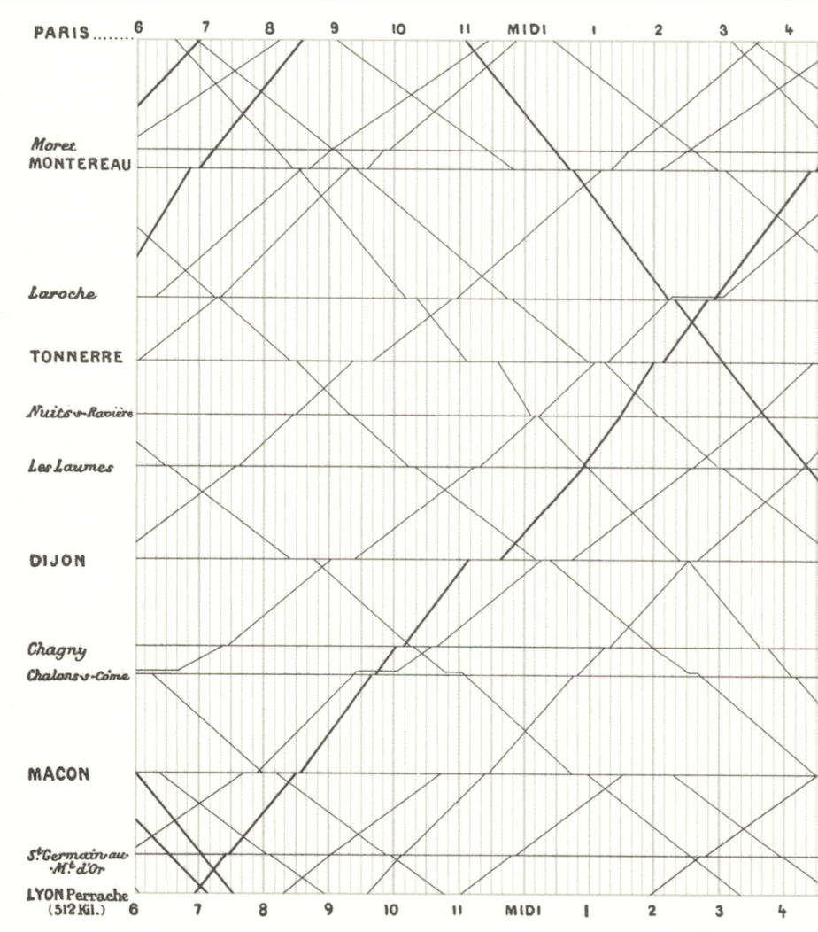
Skills Lab 3
A Samuel Pottinger
Stat 198: IDSV
Feb 19, 2025

Slide 2
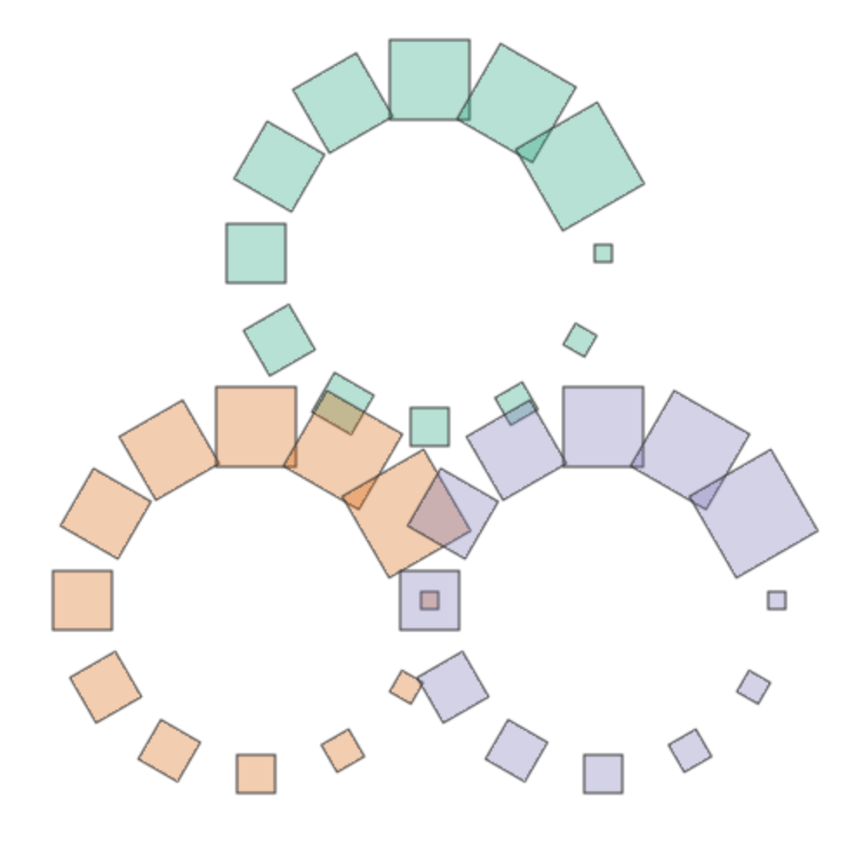
Goal is to get through Tutorial 7.
We will look at options for drawing glyphs.
https://interactivedatascience.courses/labs

Slide 3
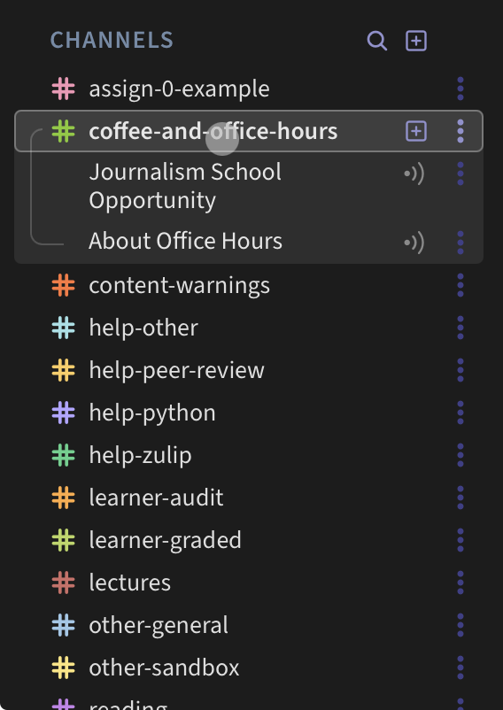
Flipped Classroom

Slide 4
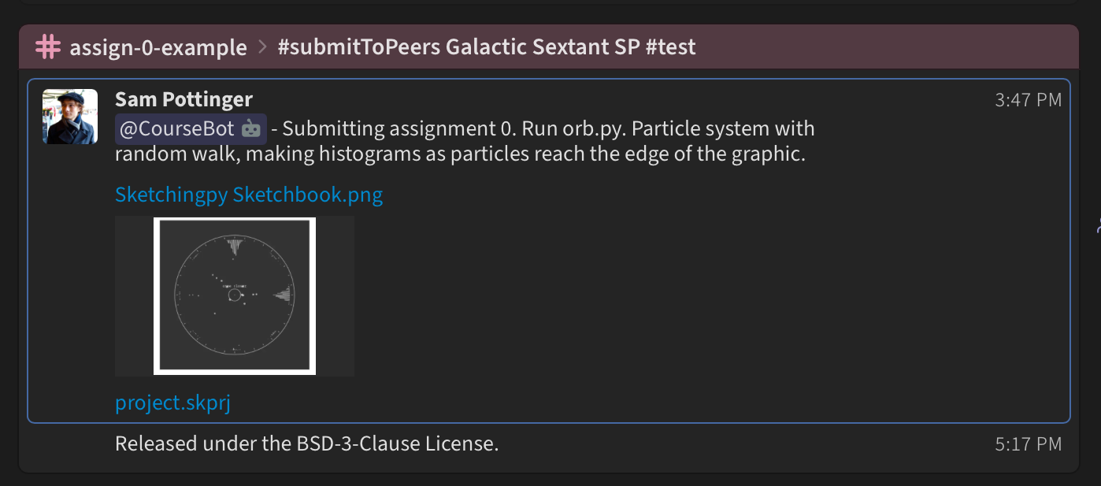
On Wednesday, we also have our first exercise which requires submitting code. Sketchingpy editor recommended. Be sure to include instructions on how to run and what license you are releasing under. Please talk to me in advance of due date if you want to use something other than Sketchingpy.
First coding assignment.

Slide 5
I’m Excited!
There’s a lot of really fun stuff coming up over the next two weeks. I can’t wait to dig in with you.

Slide 6
Sources for imagery
https://badriadhikari.github.io/data-viz-workshop-2021/minards/

Slide 7
